Slide 1
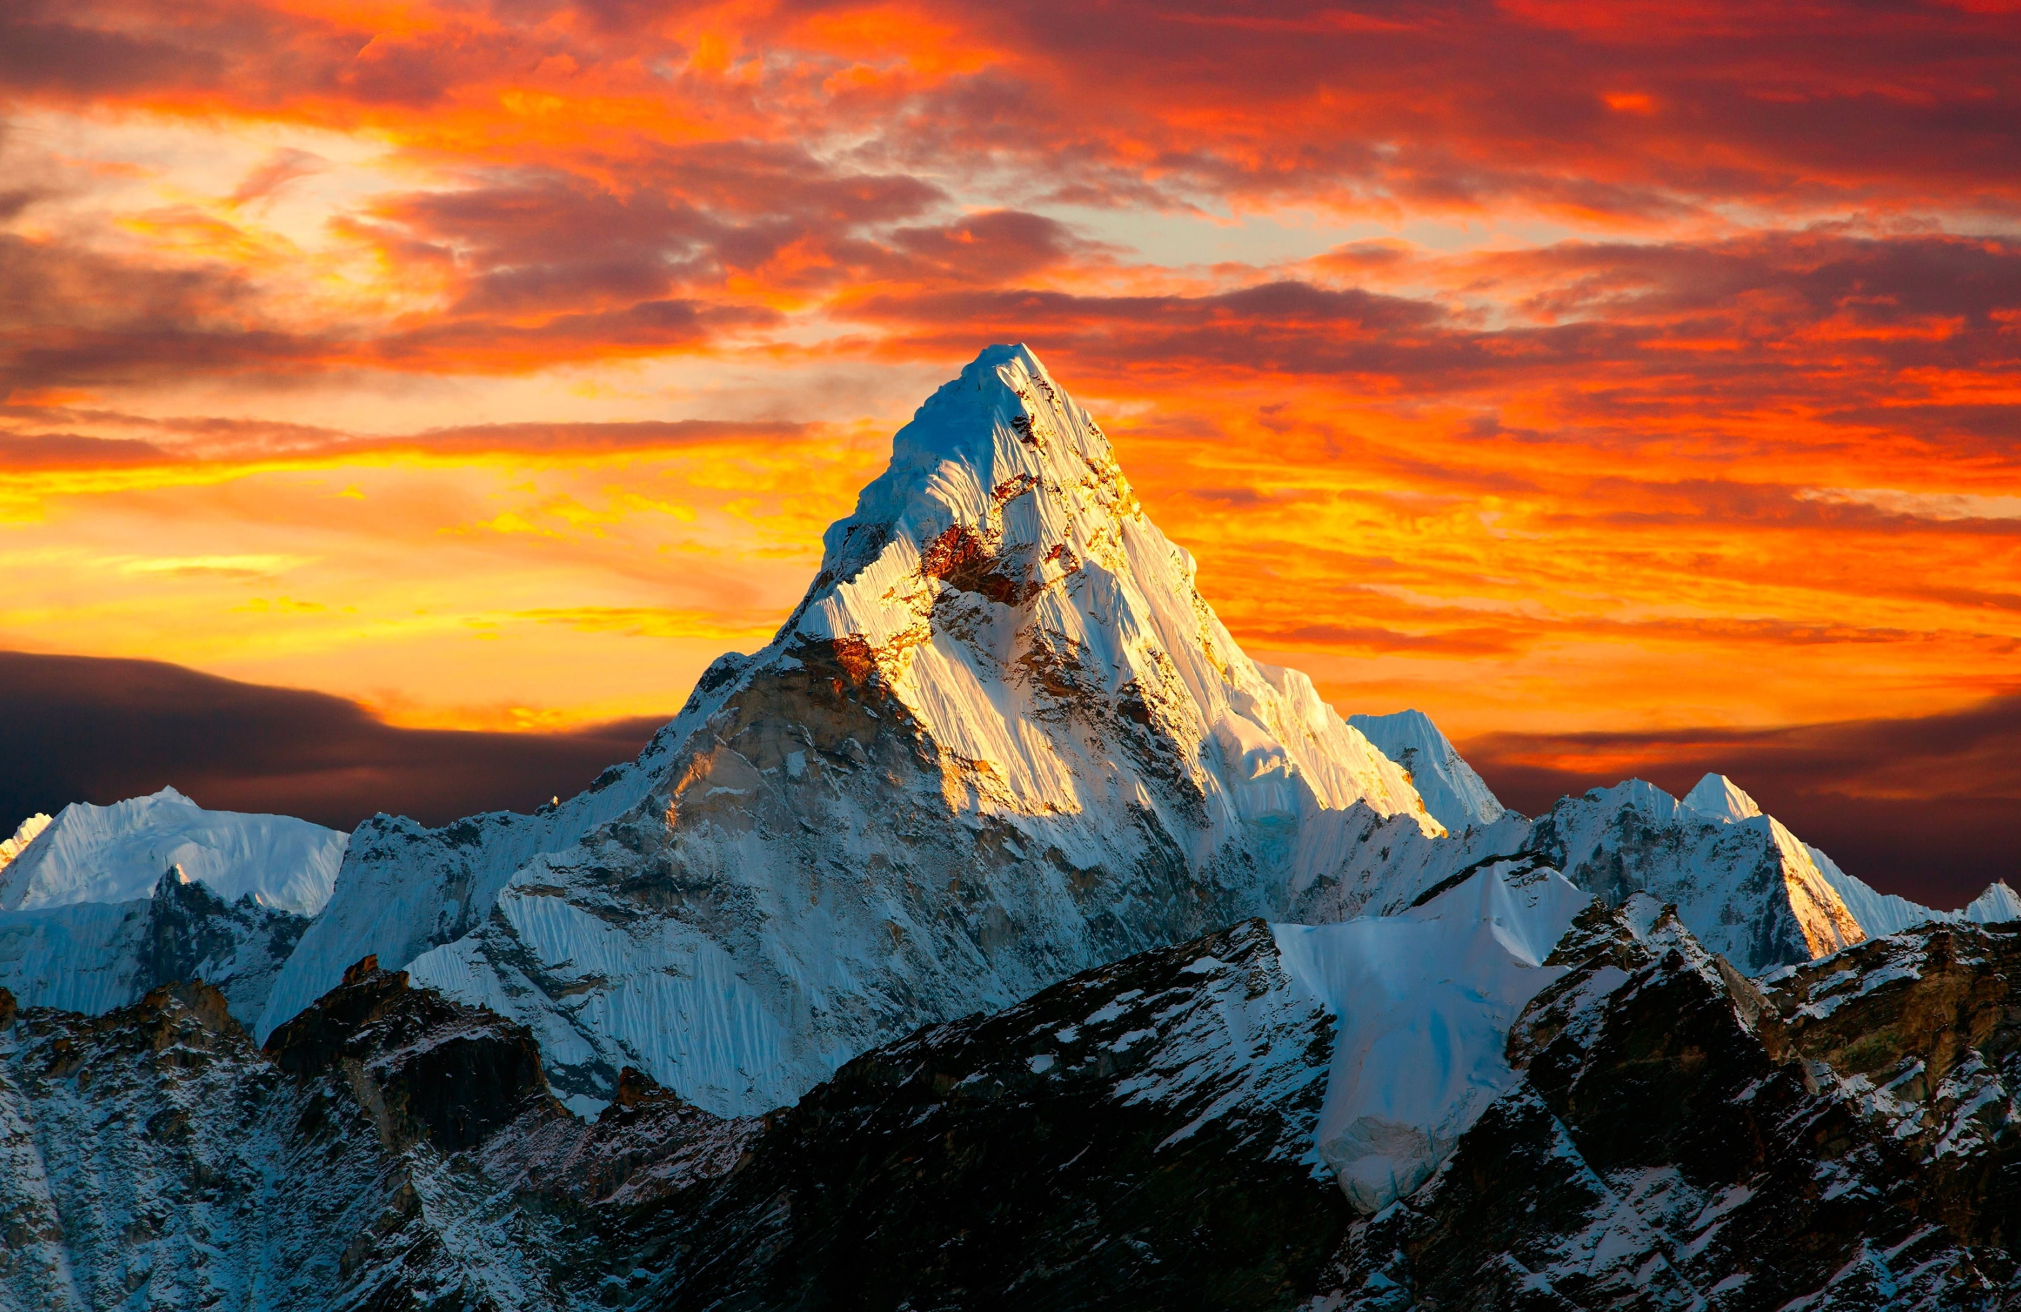
Only A Holy God

Slide 2
Who else commands all the hosts of heaven?
Who else could make every king bow down?
Who else can whisper and darkness trembles?
Only a Holy God

Slide 3
What other beauty demands such praises?
What other splendor outshines the sun?
What other majesty rules with justice?
Only a Holy God

Slide 4
Come and behold Him
The One and the Only
Cry out, sing holy
Forever a Holy God
Come and worship the Holy God

Slide 5
What other glory consumes like fire?
What other power can raise the dead?
What other name remains undefeated?
Only a Holy God

Slide 6
Come and behold Him
The One and the Only
Cry out, sing holy
Forever a Holy God
Come and worship the Holy God

Slide 7
Who else could rescue me from my failing?
Who else would offer His only Son?
Who else invites me to call Him Father?
Only a Holy God
Only my Holy God

Slide 8
Come and behold Him
The One and the Only
Cry out, sing holy
Forever a Holy God
Come and worship the Holy God

